Slide 1
Program-7
Write a program to construct a Bayesian network considering medical data. Use this model to demonstrate the diagnosis of heart patients using standard Heart Disease Data Set. You can use Java/Python ML library classes/API.

Slide 2
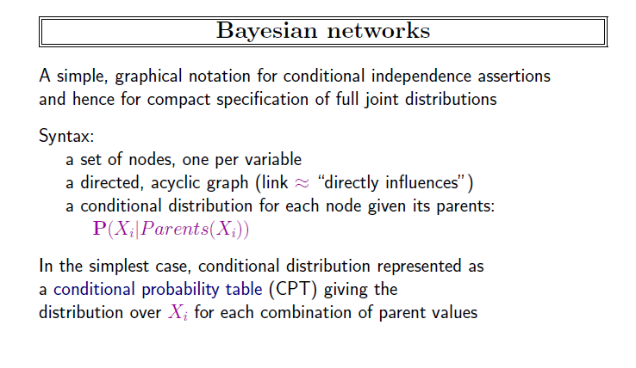
Bayesian Network

Slide 3
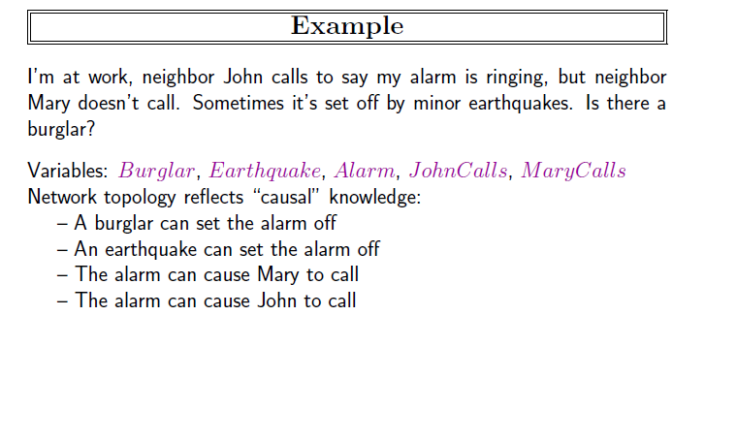

Slide 4
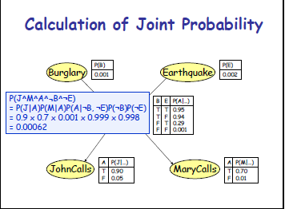

Slide 5
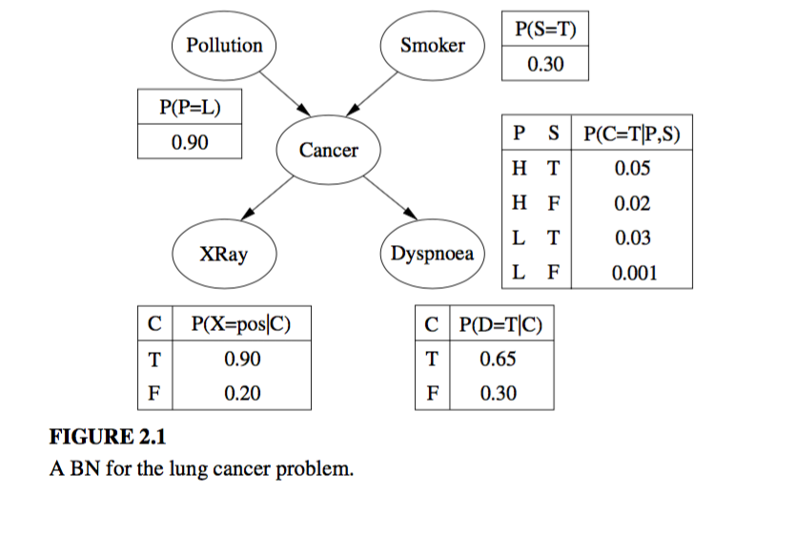
BN for lung cancer

Slide 6
Heart disease packages required
import numpy as np
import pandas as pd
import csv
from pgmpy.estimators import MaximumLikelihoodEstimator
from pgmpy.models import BayesianModel
from pgmpy.inference import VariableElimination

Slide 7
Attributes used
'age', 'sex', 'cp', 'trestbps', 'chol', 'fbs', 'restecg', 'thalach', 'exang', 'oldpeak', 'slope', 'ca', 'thal', 'heartdisease']

Slide 8
Read data
heart_data = pd.read_csv("Data7.csv")
heart_data = heart_data.replace("?", np.nan)
In case any data is missing as continuos data are there….>

Slide 9
Create model
model = BayesianModel([('age', 'trestbps'), ('age', 'fbs'), ('sex', 'trestbps'), ('exang', 'trestbps'),('trestbps','heartdisease'),('fbs','heartdisease'),('heartdisease','restecg'), ('heartdisease','thalach'), ('heartdisease','chol')])

Slide 10
Fit and infer
model.fit(heart_data, estimator=MaximumLikelihoodEstimator)
infer = VariableElimination(model)

Slide 11
inferences
q = infer.query(variables=['heartdisease'], evidence={'chol':100})
print(q["heartdisease"])

Slide 12
import numpy as np
import pandas as pd
from pgmpy.estimators import MaximumLikelihoodEstimator
from pgmpy.models import BayesianModel
from pgmpy.inference import VariableElimination
heart_data = pd.read_csv("Data7.csv")
heart_data = heart_data.replace("?", np.nan)
model = BayesianModel([('age','trestbps'),('age','fbs'),('sex','trestbps'),('exang','trestbps'),('trestbps','heartdisease'),('fbs','heartdisease'),('heartdisease','restecg'),('heartdisease','thalach'),('heartdisease','chol')])
model.fit(heart_data, estimator=MaximumLikelihoodEstimator)
infer = VariableElimination(model)
q = infer.query(variables=['heartdisease'], evidence={'chol':100})
print(q["heartdisease"])
q = infer.query(variables=['heartdisease'],evidence={'age':28})
print(q["heartdisease"])

